Slide 1

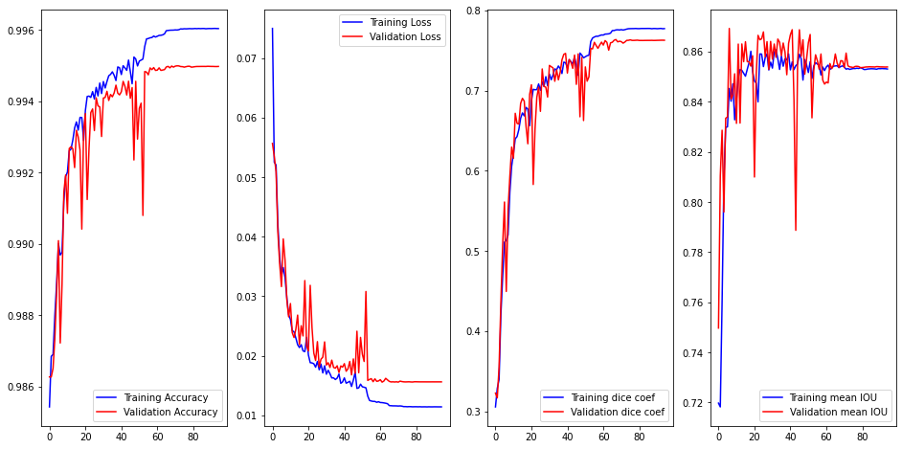
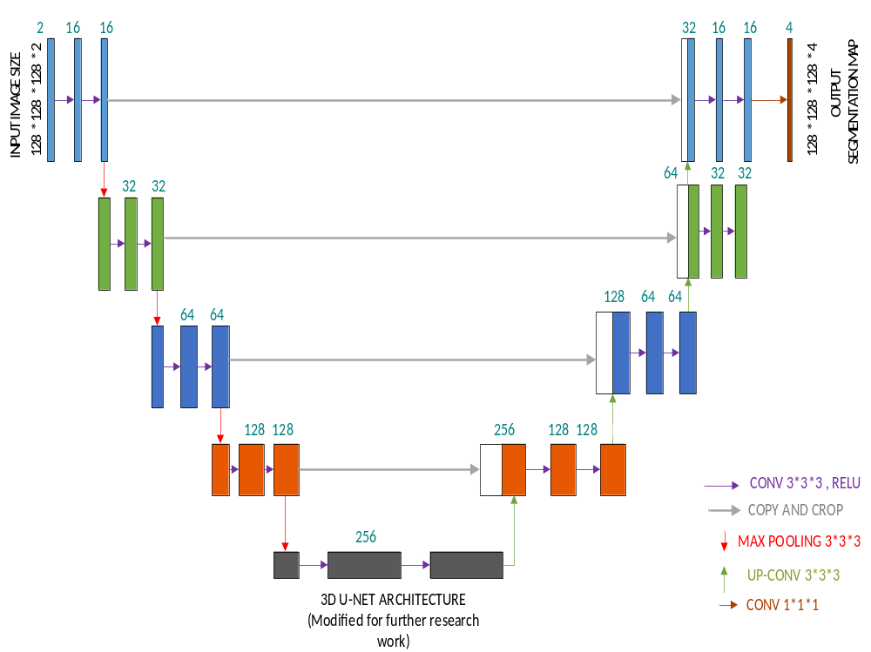
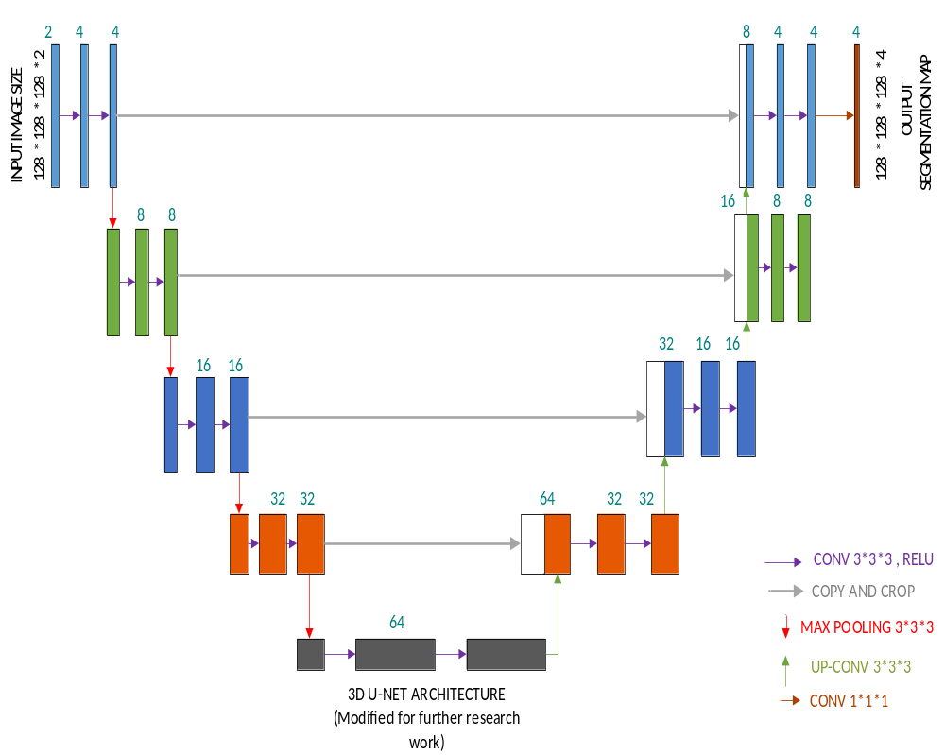
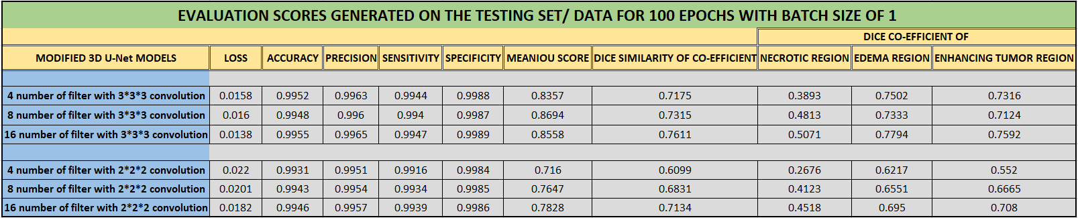
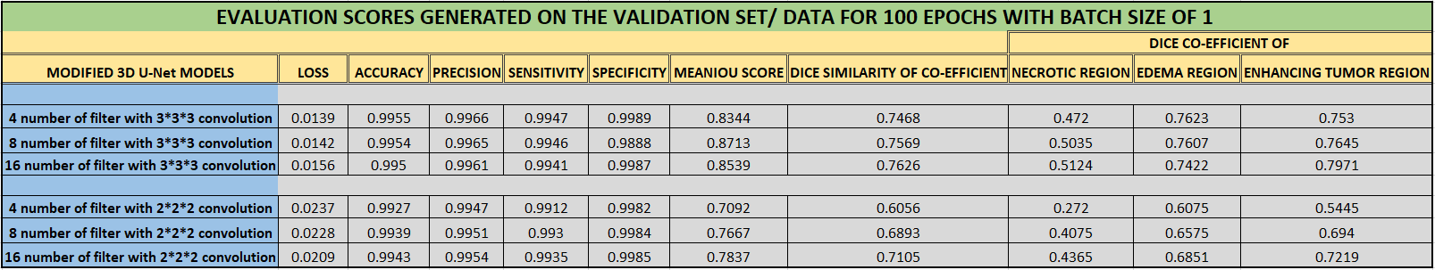
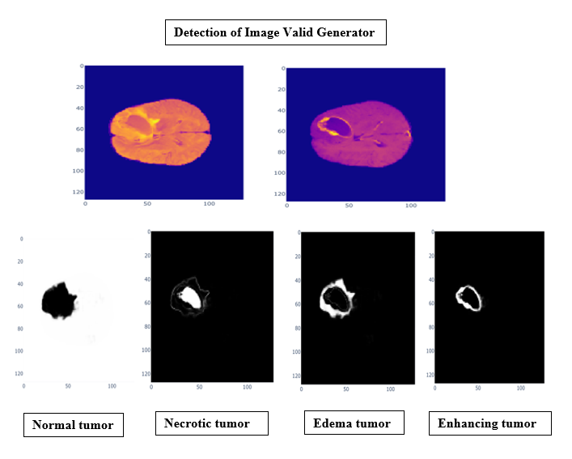
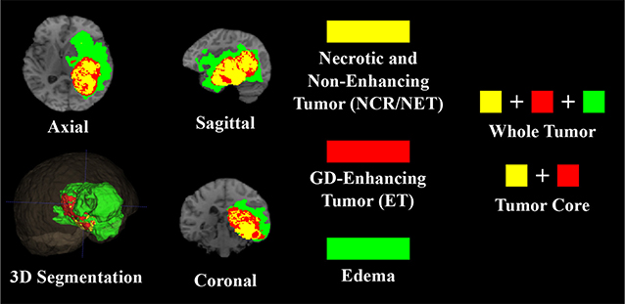
Brain Tumor Segmentation of MRI Images using
3D U-Net Model Architecture...
SADANAND VITHAL GIRADDI
School of Computer Science, University of Lincoln
ABSTRACT
In this research project, Brain tumor segmentation uses the deep learning method for segmenting brain tumors from MRI images. Glioma segmentation is more focused on the current research for detecting the presence of tumors in the brain tumor sub-regions. As manual segmentation is difficult and takes more time. Automatic Segmentation helps in saving time for the segmentation of brain tumors in MRI images. The major challenge in brain tumor segmentation is determining the tumor extent. Various state-of-art algorithms like DeepMedic, PSPNet, and V-Net are used on the segmentation of brain tumors on different datasets of the BraTS challenge. This research work focuses on the 3D U-Net model architecture that is going to be implemented on brain tumor segmentation of MRI images of the BraTS 2021 dataset for further research. The different modifications have been done by tuning the hyperparameters to the 3D U-Net model architectures for enhancing the performance of the model and comparing the evaluation results. Based on the evaluation methods like Loss, Accuracy, MeanIoU, Precision, Dice Similarity of Co-efficient, Specificity, and Sensitivity, Generating the dice scores for the tumor sub-regions like the Necrotic core region, Edema region, and enhancing tumor region the results are evaluated. The implementation of code is done on the Python Jupyter notebook script using the TensorFlow frameworks and the Keras modules.
AIM and OBJECTIVES
The main aim is to use our proposed model i.e. 3D U-Net to provide better brain tumor segmentation performance and evaluation for the BraTS 2021 dataset for 3D MRI image processing in medical applications.
The major objective of this project is to improve the segmentation of the brain tumor sub-regions: The Enhancing tumor region, the tumor core region, and the whole tumor region for the BraTS 2021 Dataset which is taken from the Kaggle competition. And for further research, the 3D U-Net implementation will be carried out by modifying the model architectures based on U-Net architecture for segmenting the brain tumor regions by enhancing the performance and evaluations that will be considered for the project.
RESEARCH METHOD
Step 1: Setting up the data.
BraTS 2021 dataset is taken.
Four different Volumes of the same region: a) T1 (native), b) T1Gd (post-contrast T1-weighted), c) T2 (weighted), and d) T2-FLAIR (T2 Fluid Attenuated Inversion Recovery)
The given size of an image is 240*240*155 and for further extracting the features from the image is resized to 128*128*128 by scaling all the volumes using the MinMaxScaler method.
Step 2: Defining the custom data generator.
The Keras image data generator only works with tif, jpeg, and png image formats. As the provided images in the dataset are in the form of .nii.gz format and this format cannot be recognized by the Keras image data generator. Therefore, for this sake, we should define the custom data generator for loading the data from the dataset.
Step 3: Evaluation methods:
Accuracy, Loss, Dice Similarity Co-efficient, MeanIoU, Sensitivity, Specificity, Precision, Dice co-efficient of necrotic, Dice co-efficient of Edema, and Dice co-efficient of Enhancing tumor of each region.
Step 4: Defining the model.
Testing the model with a 3D U-Net architecture algorithm (Our proposed approach).
Step 5: Training and Predicting the values.
Predicting the Training and Validation Accuracy, Dice Similarity co-efficient Score, Precision, Sensitivity, and Plotting the data with visualization.
Prediction of the image in Valid Generator.
RESULTS
INTRODUCTION
Brain tumors are divided into two categories. They are 1) Primary tumor type and 2) Secondary tumor type. In the primary tumor type, the tumor cells are originated from the brain, and in the secondary tumor type, the tumor cells are originated from the other organs of the body, and later they are metastasized into the brain. Gliomas are the primary tumor type. And in metastasized situations, in any area of the body, they develop malignant cells which are cancerous in nature and can then spread and cause to the brain (Işın, Direkoğlu and Şah, 2016). The Brain tumor segmentation of MICCAI challenge aims for providing the accurate segmentation of tumors in the MRI images (Menze et al., 2015) and (Bakas et al., 2019). The modern methods are used for segmenting brain tumors are examined using the cutting-edge approaches in the Brain tumor segmentation of BraTS Challenge.
Glioma is the primary tumor that originated in the glial cells of the brain and is classified as low-grade and high-grade glioma. High-grade gliomas are considered as the most aggressive form of disease having a survival rate of two to three years which requires immediate treatment and for low-grade gliomas are less aggressive and slower-growing low-grade variants when it is compared with high-grade gliomas. Neuroimaging protocols were applied for both groups to evaluate the disease's progression before and after the treatment by applying the success of chosen strategy for treatment. Gliomas research is more prevalent in today’s scenario case. The importance of early treatment plays a major role in diagnosing using CT scans, MRI scans are used to determine the size and location of brain tumors (Menze et al., 2015).
The accurate and automatic segmentation of brain tumor sub-regions with respect to their boundaries in Magnetic Resonance Images (MRI) is more important in medical applications such as monitoring the tumor growth of the brain and generating radiotherapy maps. Earlier radiologists used to do manual detection for MRI scans or CT scans for tracing the tumor sub-regions of the patients. However, this process is time-consuming, tedious, and becomes impractical when radiologists are dealing with numerous patients. This has been highlighted to go for automatic segmentation for detecting the exact location of gliomas present in the tumor regions where this can be achieved using the deep learning of various state-of-the-art tumor segmentation algorithm methods for increasing the performance of detection in the tumor sub-regions (Baid et al., 2021).
This Research project discusses Brain Tumor Segmentation and evaluation of the BraTS 2021 dataset. In this work, we are modifying the 3D U-Net architecture by giving different numbers of filters with different kernel sizes and adding dropout layers for the model.
Training and validation curves for Accuracy, Loss, dice co-efficient and Mean IOU scores for 3D U-Net model having 16 number of filters with kernel size of (3, 3, 3).
Modified 3D U-Net Architecture.
CONCLUSION From the research point of view, the segmentation of MRI images of brain tumors done manually is more challenging, difficult, and takes more time. To overcome the manual segmentation, further research has been carried out to save time for doing the Automatic segmentation of MRI images of brain tumors. The challenging part in doing the automatic segmentation is finding the exact size of the tumor and the location of gliomas present in the brain tumor. The various state-of-art methods are employed for the segmentation of MRI images in the brain tumor segmentation of the BraTS 2012 to 2021 dataset of the BraTS challenge. This project implements the 3D U-Net model and the modified 3D U-Net model architectures for the Brain tumor segmentation of the BraTS 2021 dataset. The evaluation methods chosen for Brain tumor Segmentations are Loss, Accuracy, MeanIoU, Precision, Dice Similarity of Co-efficient, Specificity, Sensitivity, The tumor sub-regions like Dice Co-efficient of Necrotic core region, Dice Co-efficient of Edema region, and Dice Co-efficient of Enhancing tumor region. The testing set and the validation set results show that the modified 3D U-Net models architecture can achieve excellent performance and each model trained are end-to-end fashioned. The tuning of model architectures' hyperparameters helped produce good dice similarity scores of the tumor sub-regions for the Necrotic core region, Edema core region, and the enhancing tumor core region.
Detection of tumor sub-regions of MRI images
ACKNOWLEDGEMENT
I would like to convey my special thanks and sincere gratitude to my supervisor Dr. Lei Zhang, for his wonderful support and the guidance that he has given me in the supervisor meetings and via email to accomplish this research project.
Detection of images in the Valid Generator.
Research Project (CMP9140M-2122)

